Slide 1
A Project Presentation On “ Role-Based Blogging & Article Review Portal.”
Presented By
Akshada Kshirsagar
Shweta Avhad
Vidya Thange
Diploma in Advanced Computing
Infoway Technologies
August-2025

Slide 2
OVERVIEW
Introduction
Problem statement
Objectives
System Architecture
Methodology
System Requirements
Advantages
Future Scope
Conclusion

Slide 3
INTRODUCTION
The Role-Based Blogging and Article Review Platform is a web-based application designed to enable collaborative content creation and moderated publishing through secure role-based access control. The platform supports multiple user roles -Admin, Editor, Author, Reviewer, and Reader-each with clearly defined permissions and responsibilities.

Slide 4
PROBLEM STATEMENT
The Role-Based Blogging and Article Review Platform enables collaborative content creation and controlled publishing through secure role-based access for Admin, Editor, Author, Reviewer, and Reader roles.

Slide 5
OBJECTIVES
To implement secure role-based access control for Admin, Editor, Author, Reviewer, and Reader roles.
To implement secure role-based access control for Admin, Editor, Author, Reviewer, and Reader roles.
To develop a web-based platform that supports collaborative content creation and moderated publishing.
To implement secure role-based access control for Admin, Editor, Authors, Reviewer and Reader only.
To build a responsive and user-friendly frontend using React.js.

Slide 6
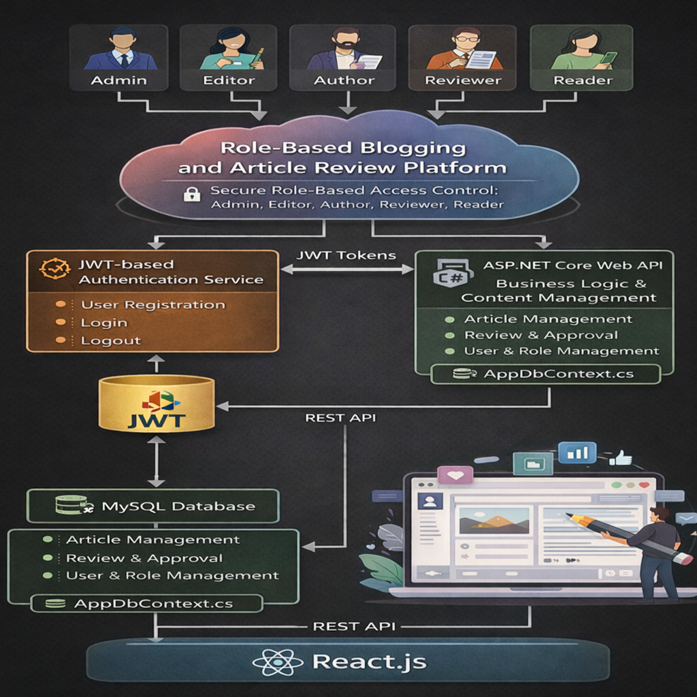
SYSTEM ARCHITECTURE

Slide 7
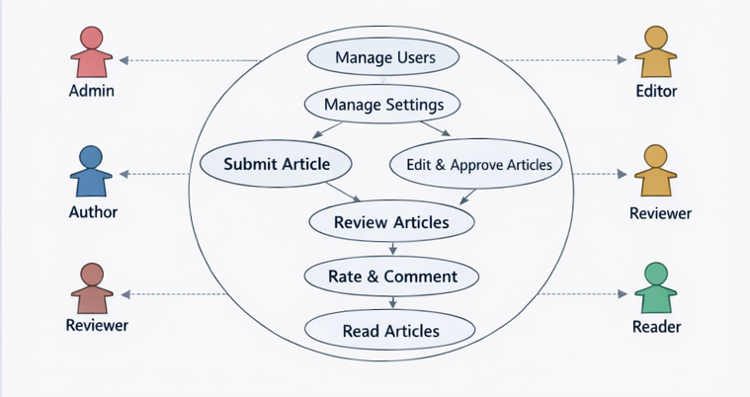
USER CASE DIAGRAM

Slide 8
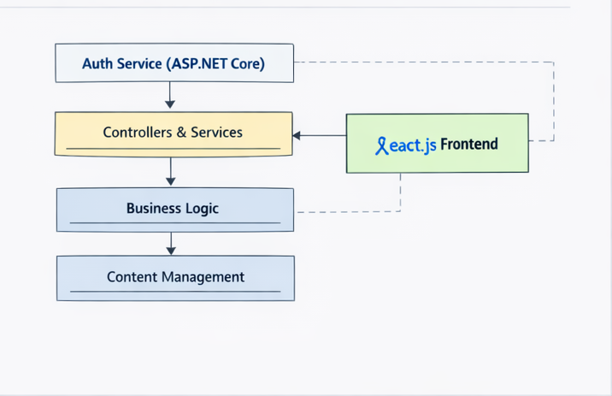
PACKAGE DIAGRAM

Slide 9
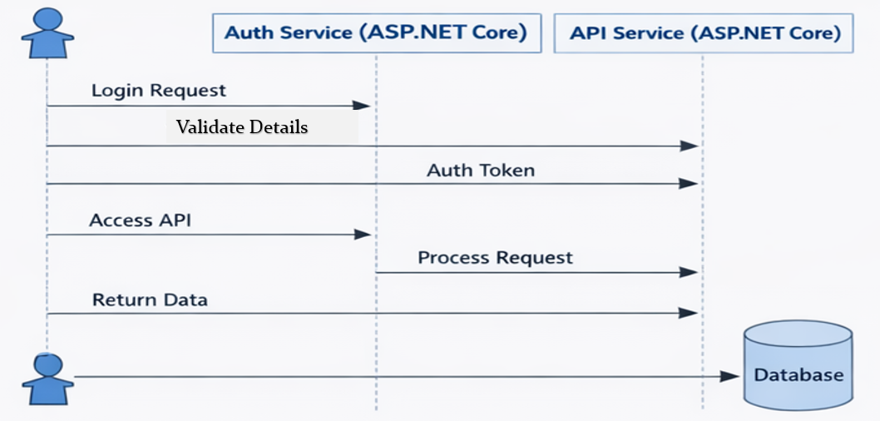
SEQUENCE DIAGRAM
Validate Details

Slide 10
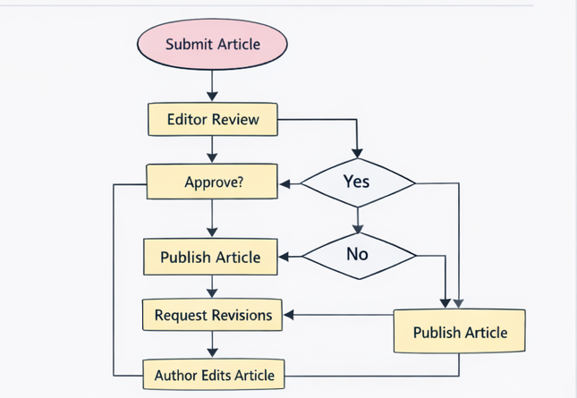
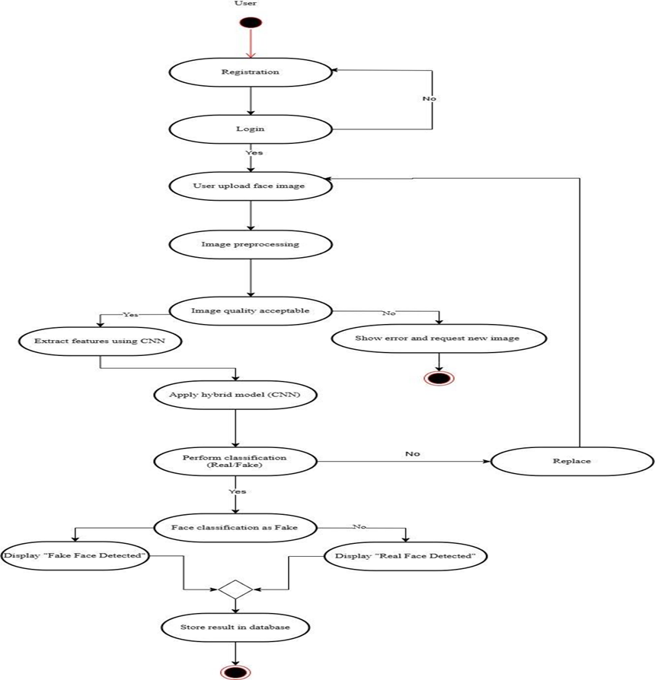
ACTIVITY DIAGRAM

Slide 11
METHODOLOGY
The project follows a structured development approach starting with requirement analysis to define role-based access for Admin, Editor, Author, Reviewer, and Reader. A hybrid system architecture is designed where JWT handles authentication services such as registration, login, and logout, while ASP.NET Core Web API manages business logic and content operations. The frontend is developed using React.js to provide a responsive and interactive user interface. All components are integrated to ensure secure communication, followed by role-based testing to validate functionality and system performance.

Slide 12
WORKING OF Modules
User Registration & Login
Role Assignment (Admin, Editor, Author, Reviewer, Reader)
Article Creation by Authors
Review & Approval by Editors
User & Platform Management by Admin
Publication & Interaction (Comments & Ratings)
Backend Handling via ASP.NET Core Web API

Slide 13
SYSTEM REQUIREMENT
Software Requirements
Operating system : Windows 7 Onwards
Technology : ASP.NET Core
IDE : Microsoft Visual Studio code.
Front End: HTML,CSS, Bootstrap and React.js
Database : MySQL
Hardware Requirements
Processor : Intel I3/I5 Processor.
Hard Disk : Min 500GB.
RAM : 8GB

Slide 14
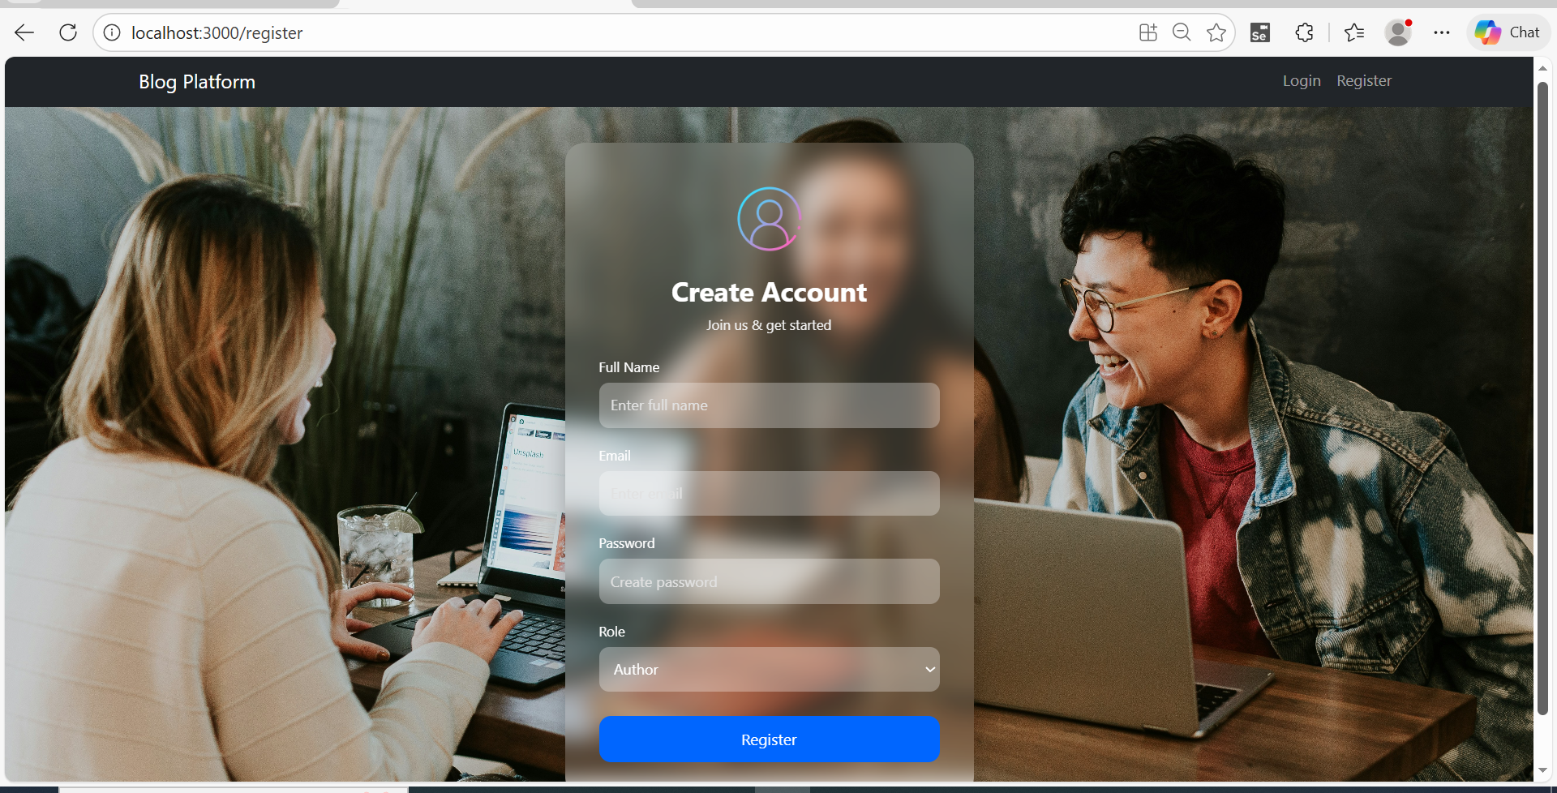
Registration Module

Slide 15
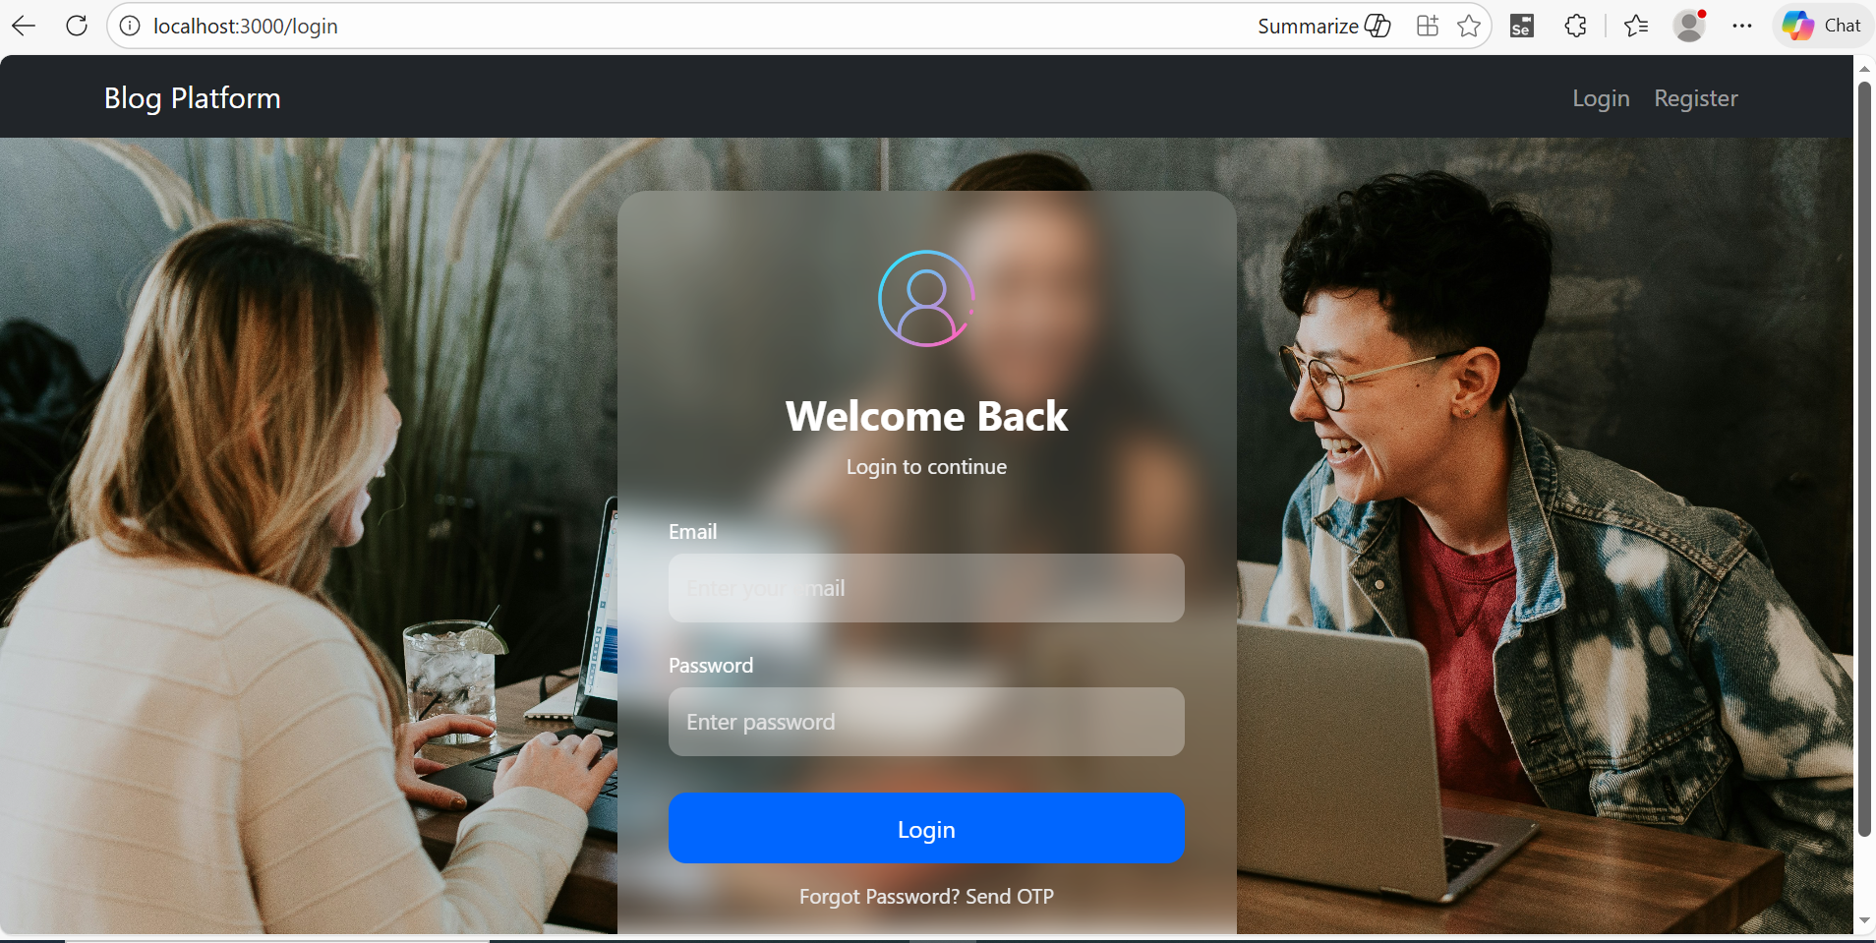
Login Module

Slide 16
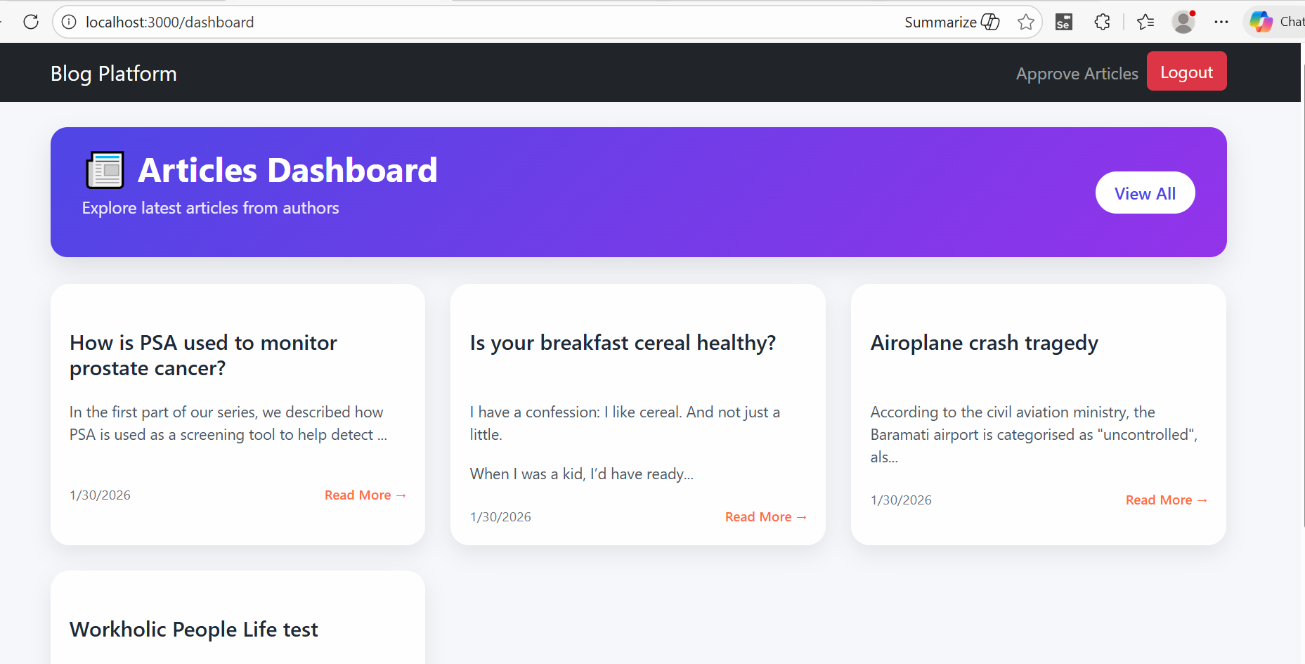
Home Page

Slide 17
FUTURE SCOPE
Real-Time Notifications.
Multi-Language Support.
Integration with External Platforms.

Slide 18
ADVANTAGES
Role-Based Access Control.
Secure Authentication Mechanism.
Easy Maintenance and Testing.
Real-World Application Relevance.
Better User Experience.

Slide 19
CONCLUSION
The Role-Based Blogging and Article Review Platform provides a secure and efficient solution for collaborative content creation using role-based access control. The system ensures a structured article submission, review, and publishing workflow with a scalable and user-friendly web interface.

Slide 20
THANK YOU…

